Slide 1
« Problems of environment»

Slide 2
We are all elements of global ecosystem
People have lived on our planet for many years. We may live on different continents and in different countries, but we all depend on our planet, on the sun, on animals and plants around us. We must take care of the Earth but not destruct the wildlife.

Slide 3
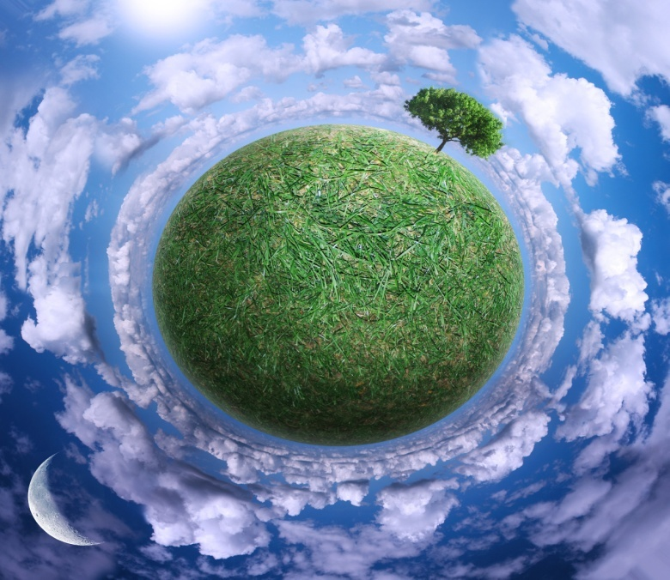
The protection of the environment
There are many big and small rivers, green forests, high mountains, lakes and seas.

Slide 4
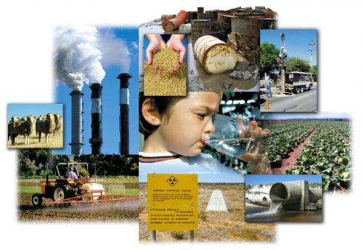
But the problem of environmental protection is urgent today.
Through their daily activities people pollute and contaminate
land, water and air.

Slide 5
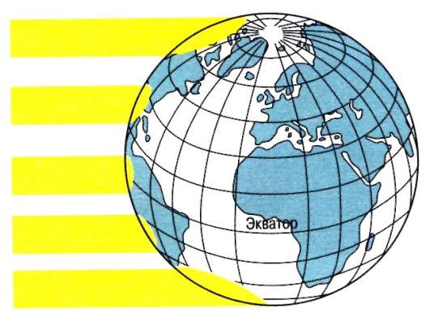
Many species of animals and birds are disappearing nowadays. We cut down trees to make furniture, but we forget that people can’t live without trees and plants. Every little creature or thing on Earth plays its own part

Slide 6
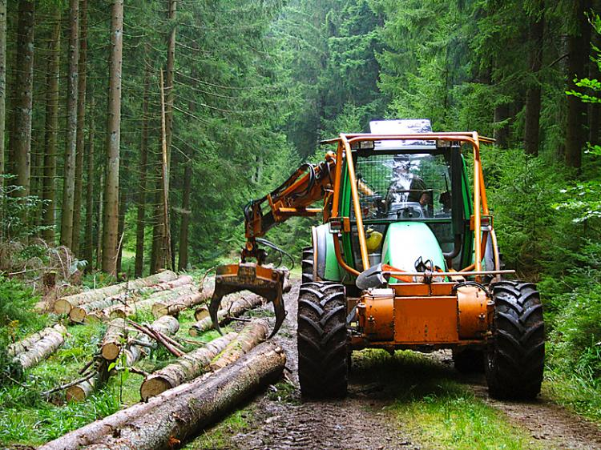
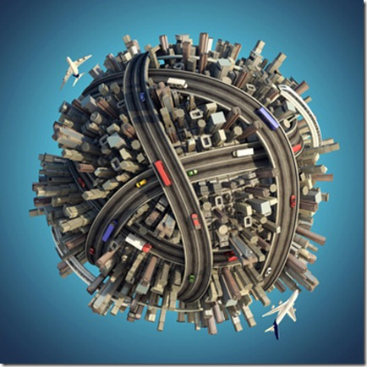
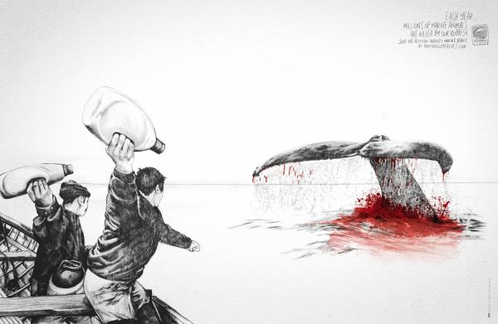
Millions of animals die every year because people have polluted their natural homes.
Besides every year people cut down more trees, build more roads, and use more land for farming.

Slide 7
Safe solutions are still needed
One of the biggest eco problems is pollution. The main reason of pollution is rubbish. .

Slide 8
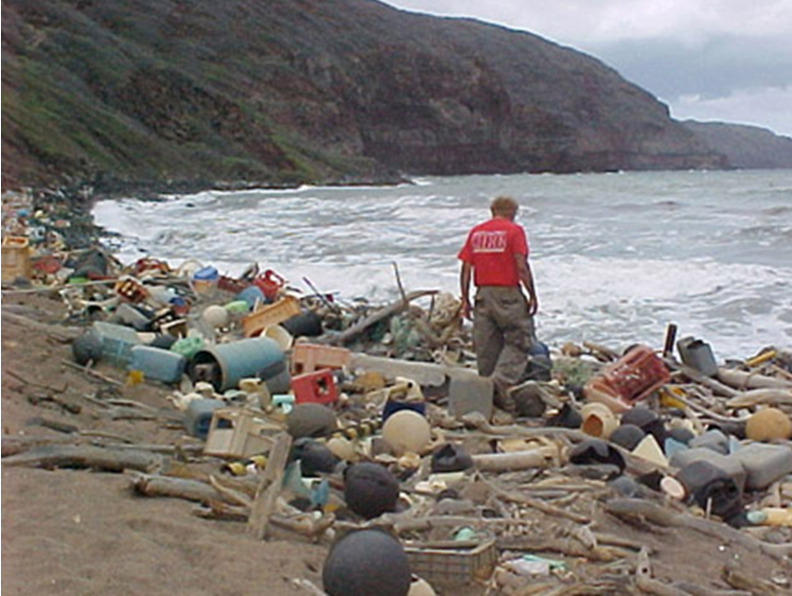
There is no ocean or sea which is not
used as a dump.

Slide 9
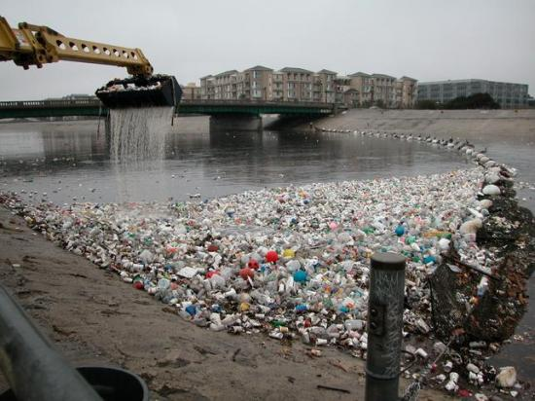
Many rivers and lakes are polluted.

Slide 10
Another way to get rid of rubbish is to burn it. But the fires make poisons, which go into the air and pollute it. This is the task scientists should get interested in. Such researchers are worth spending money on.

Slide 11
Air pollution in the chain of global destruction
Every year world industry pollutes the atmosphere with million tons of dust and harmful substances. Many cities suffer from smog. Forests are cut down and burn in fire.

Slide 12
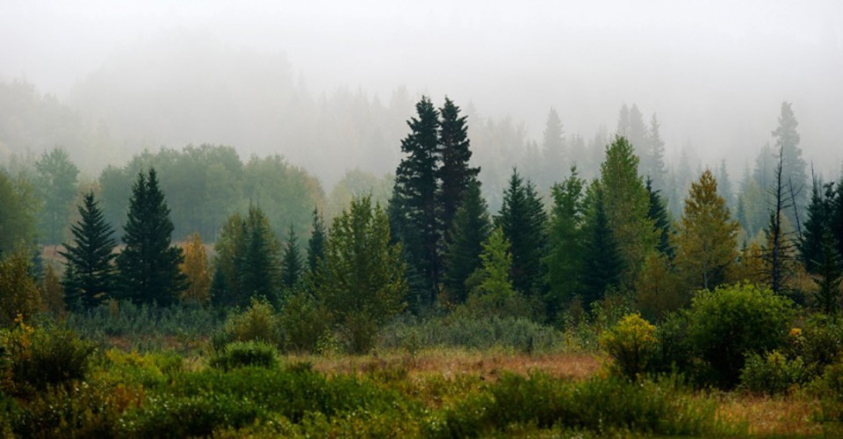
As a result some rare species of animals, birds, fish and plants disappear forever, a number of lakes and rivers dry up.

Slide 13
People created factories, which smoke and throw wastes into rivers, pollute the environment!

Slide 14
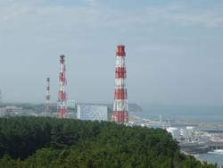
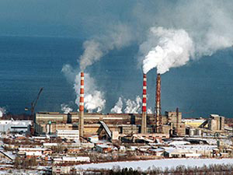
Power stations can cause
nuclear pollution

Slide 15
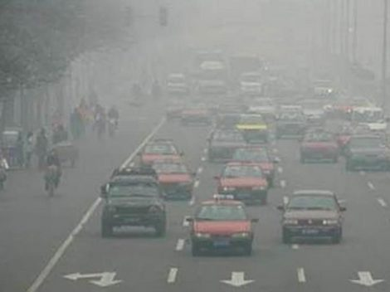
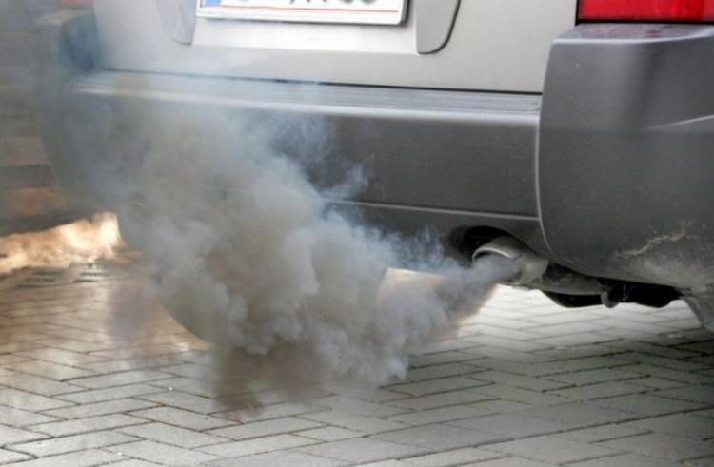

Slide 16
Greenpeace began its work 20 years ago from saving whales. And now Greenpeace is a world-famous organization, which saves plants, animals and people.

Slide 17
To solve environmental problems we should…

Slide 18
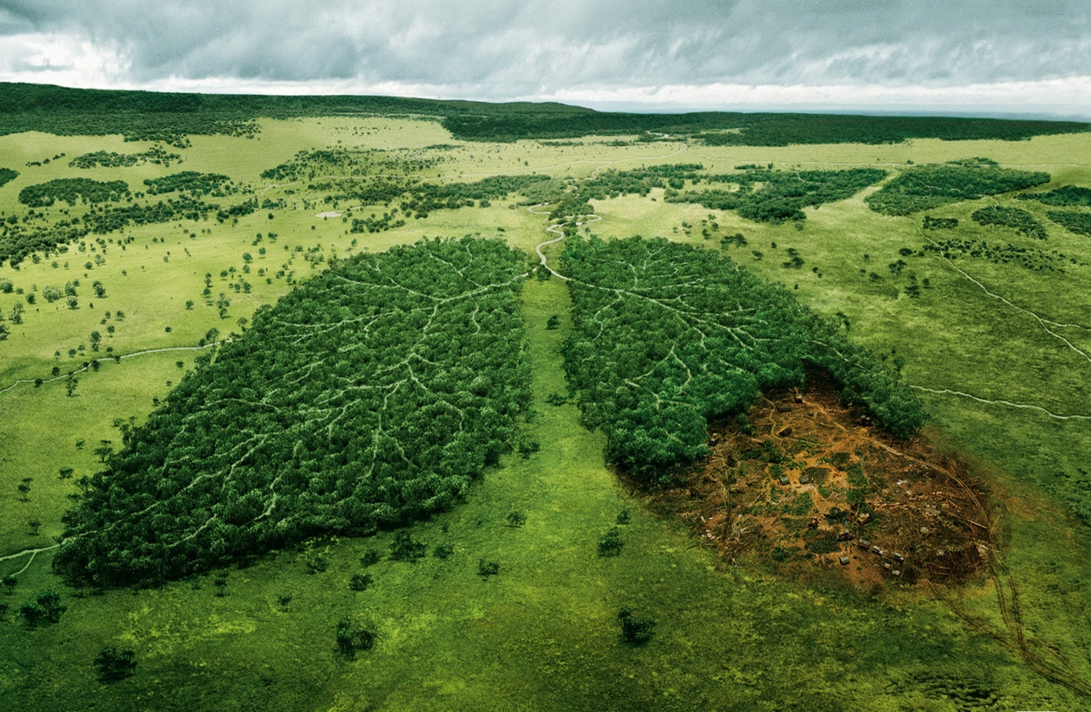
Keep yourself informed about environmental problems.

Slide 19
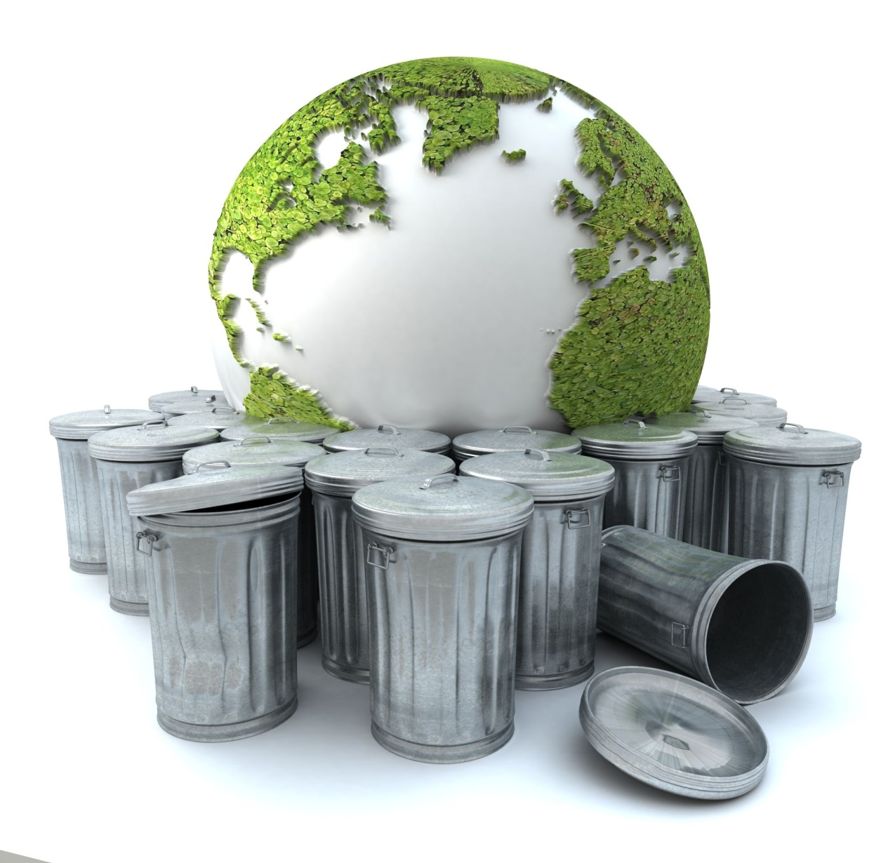
Take as much rubbish as you can to local recycling centers.

Slide 20
Before you buy anything, ask yourself if you really need it.

Slide 21
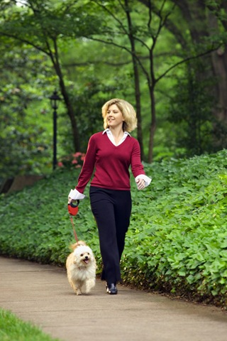
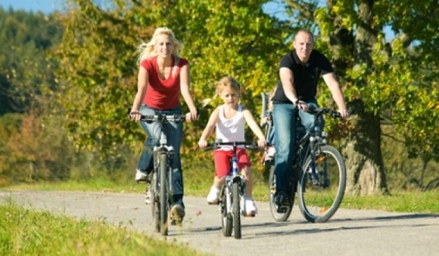
Walk or cycle whenever possible.

Slide 22
Never drop litter.

Slide 23
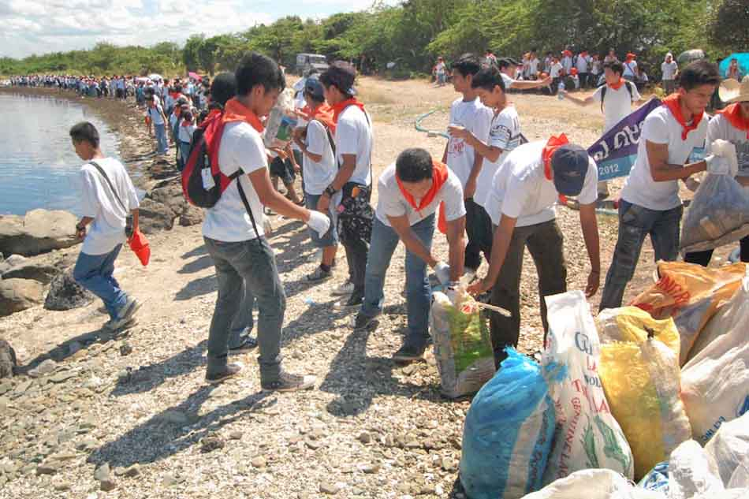
Help to clean up your local environment with your friends

Slide 24
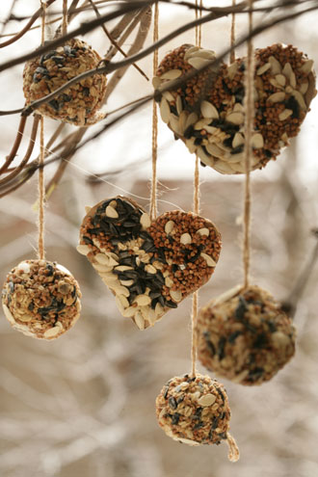
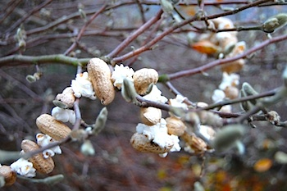
Put out food for wild animals in winter.

Slide 25
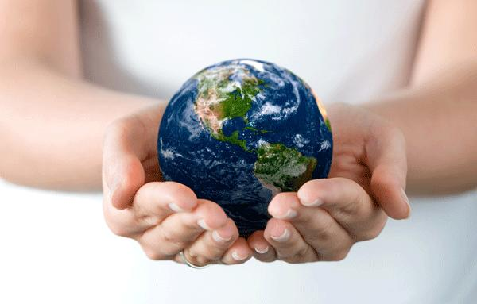
Nature is our home!
We should protect the environment!

Slide 26
Задание: Написать конспект лекции в тетрадь письменно.
Работы присылать Вк или на Gordoalena@yandex.ru
ЗАДАНИЯ ВЫПОЛНЯЕМ И ПРИСЫЛАЕМ в день, когда у Вас лента по расписанию.

