Slide 1
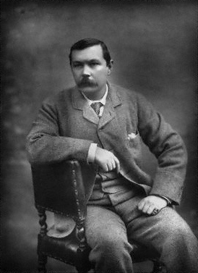
Sir
Arthur Conan Doyle
(22 May 1859 – 7 July 1930)
Ex.: You have to transform the given words into a new words
by adding the correct suffixes or prefixes.
Ex.:

Slide 2
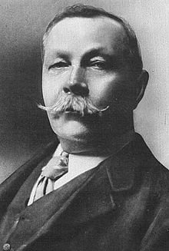
Family
fame
create
the world over as the
of Sherlock Holmes, Sir Arthur Conan Doyle
was born in Edinburgh in 1859 in
an Irish family. Arthur's father was an alcoholic,
and his caused his family much .
Arthur probably got the to tell stories from his mother
who was a source of to him.
fortune
behave
happy
able
inspire

Slide 3
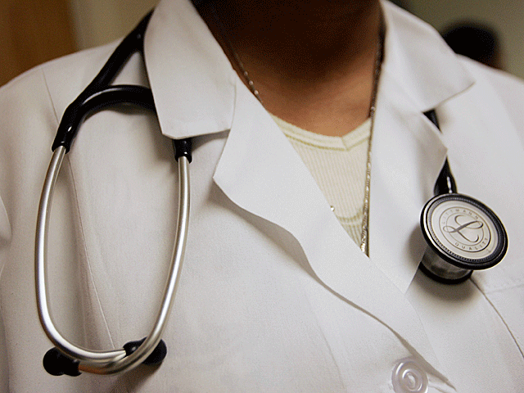
Occupation
generous
Thanks to the of some
relatives, Arthur was able to study
medicine at Edinburgh University. He was a bright student,
But , and it led him to accept a contract as
ship's surgeon. home, he completed his medical
studies in 1881. He eventually settled in the south of England.
adventure
return
generous – щедрый
led (past of lead) – привело

Slide 4
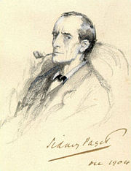
Sherlock Holmes
Telling stories had always been a part of his life,
but the of a fictional detective
called Sherlock Holmes turned Conan Doyle
into a popular . It is believed that he based Holmes'
character on one of his university tutors, Dr. Joseph Bell,
whom he regarded with respect and for his logic
and powered of .
create
write
admire
deduce

Slide 5
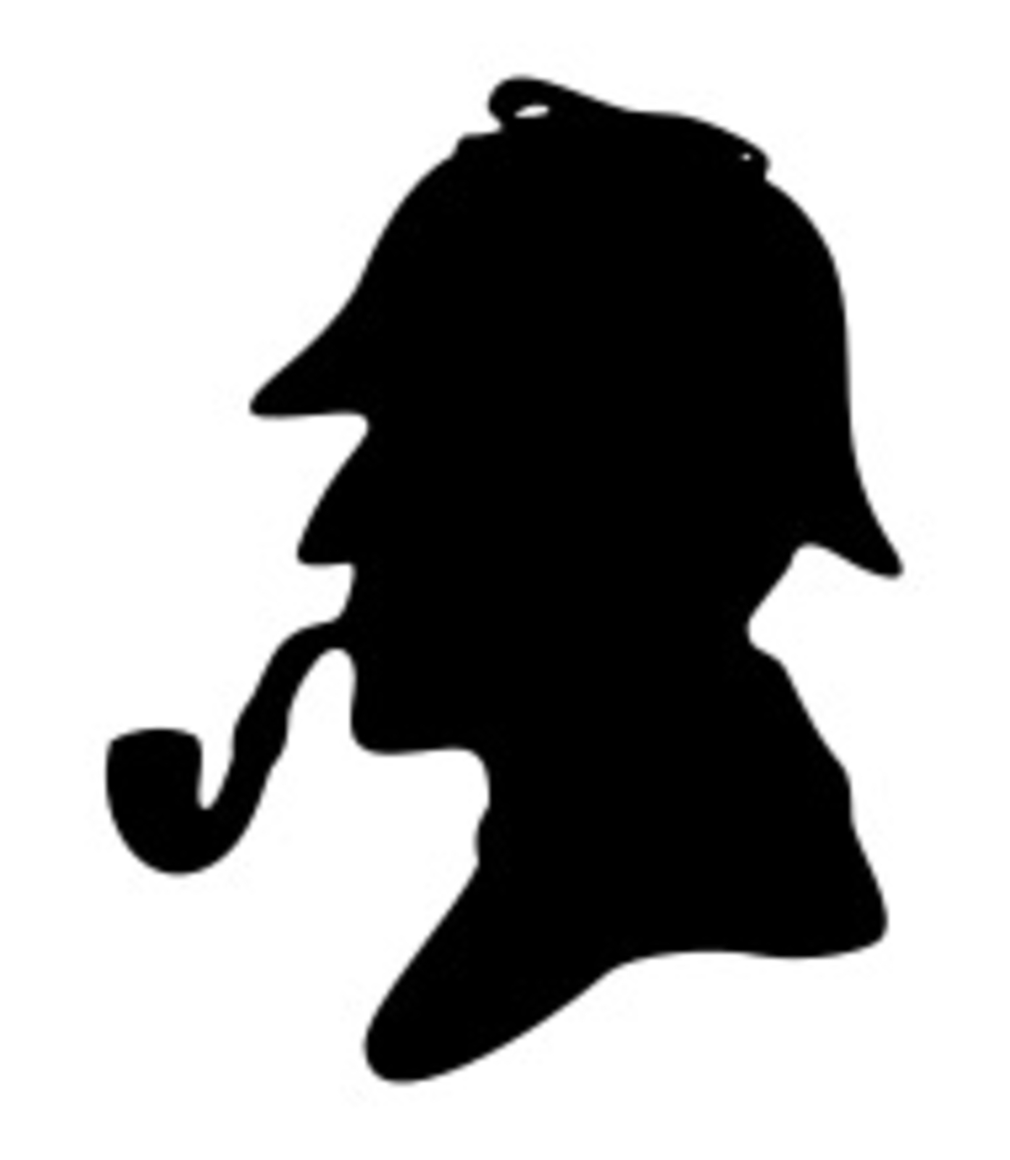
Sherlock Holmes
The first Sherlock Holmes story was so well received that
Doyle was to write more. In 1893 he killed off
his hero in order to concentrate on what he saw
as more serious work. Public outcry, however, led to bring
the character back in 1901.
courage
write
Outcry – протест, резонанс

Slide 6
Задания:
1. Выполнить задание по тексту.
Работы присылать Вк или на Gordoalena@yandex.ru
ЗАДАНИЯ ВЫПОЛНЯЕМ И ПРИСЫЛАЕМ в день, когда у Вас лента по расписанию.

