Slide 1
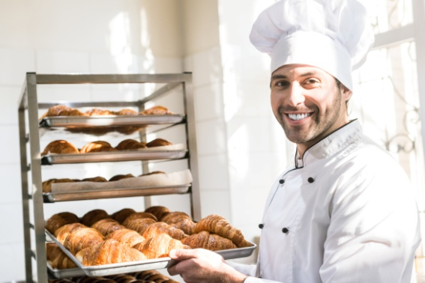
Professions

Slide 2
baker
[ ˈbeɪkəʳ ]

Slide 3
director
[ daɪˈrektəʳ ]

Slide 4
reporter
[ rɪˈpɔ:təʳ ]

Slide 5
author
[ ˈɔ:θəʳ ]

Slide 6
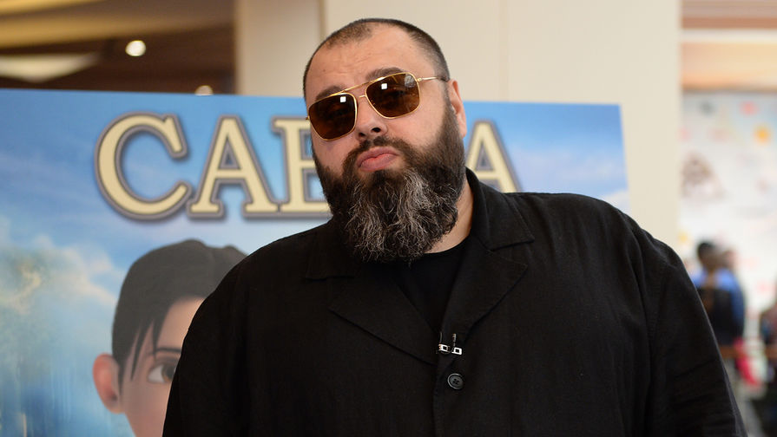
producer
[ prəˈdju:səʳ ]

Slide 7
architect
[ ˈɑ:kɪtekt ]

Slide 8
editor
[ ˈedɪtəʳ ]

Slide 9
accountant
[ əˈkaʊntənt ]

Slide 10
presenter
[ prɪˈzentəʳ ]

Slide 11
nurse
[ nɜ:s ]

Slide 12
newsreader
[ˈnju:zˌri:dəʳ ]

Slide 13
graphic designer
[ ˈɡræfɪk dɪˈzaɪnəʳ ]

Slide 14
sound engineer
[ saʊnd ˌendʒɪˈnɪəʳ ]

Slide 15
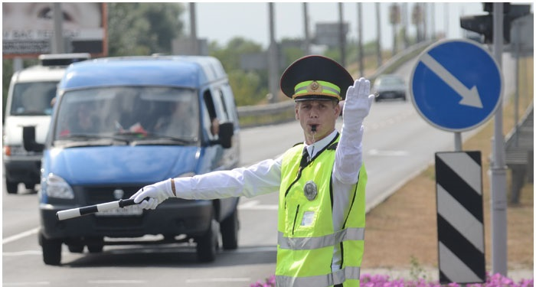
traffic warden
[ ˈtræfɪk ˈwɔ:dən ]

Slide 16
pizza delivery boy
[ ˈpi:tsə dɪˈlɪvəri bɔɪ ]

Slide 17
Choose only media jobs
Media jobs
the professions which
are connected with
television, radio, newspapers.

Slide 18
baker
editor
producer
architect
reporter
presenter
pizza delivery boy

Slide 19
director
newsreader
nurse
traffic warden
accountant
author
sound engineer

Slide 20
Listen to four audio
recordings. Match
the recordings to the
appropriate jobs.

Slide 21
director
newsreader
producer
presenter
reporter
editor
sound engineer

Slide 22
Задания:
Перевести лексику
Выполнить упражнения
Работы присылать Вк или на Gordoalena@yandex.ru
ЗАДАНИЯ ВЫПОЛНЯЕМ И ПРИСЫЛАЕМ в день, когда у Вас лента по расписанию.

