Slide 1
Тема:
Выполненные задания отправлять на почту
Gordoalena@yandex.ru

Slide 2
The mass media

Slide 3
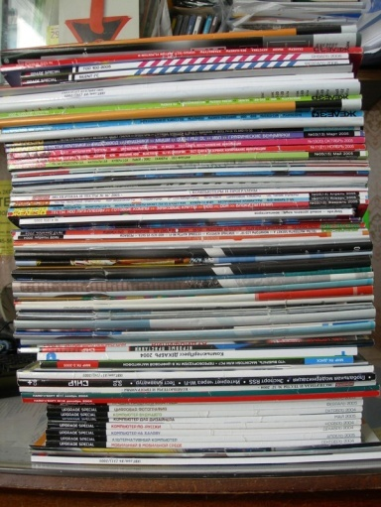
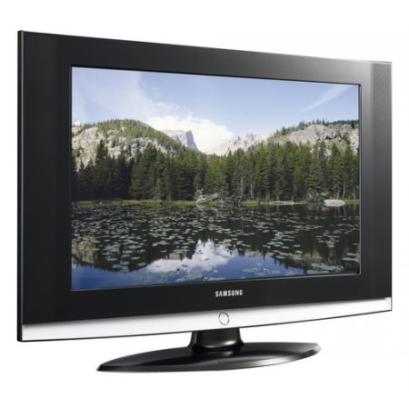
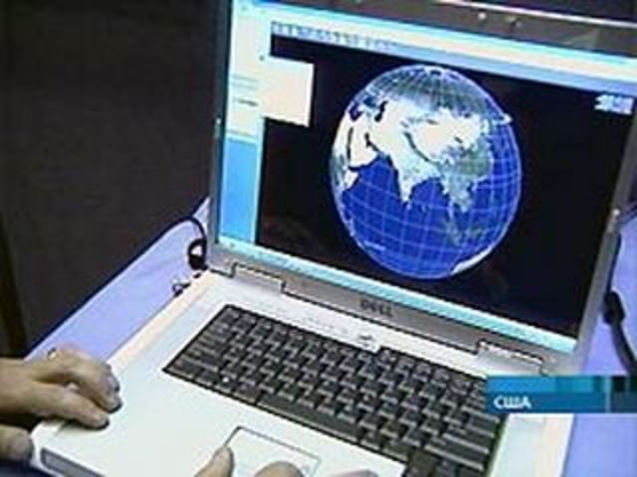
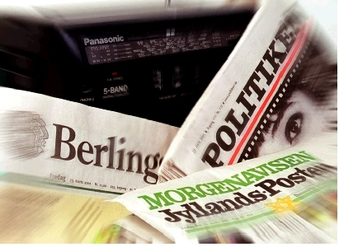
What is the media?
radio
press
television
internet

Slide 4
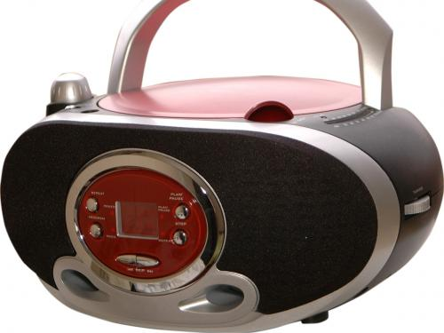
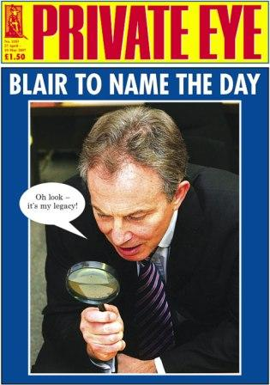
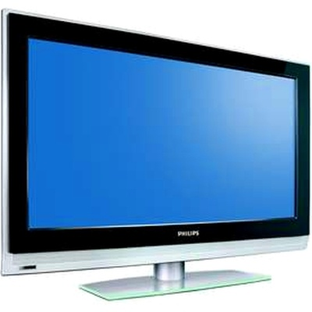
educate
inform
The role of the Media in our life
entertain

Slide 5
How do people use the media?
?

Slide 6
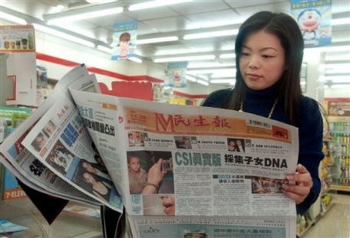
The media help people
To receive information – получать информацию
To relax- отдыхать
To entertain -развлекать
To travel around the world without wasting money- путешествовать по миру без затрат

Slide 7
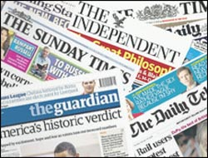
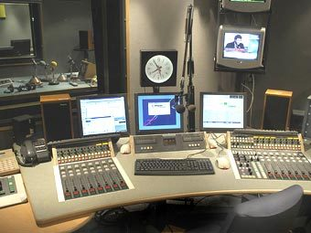
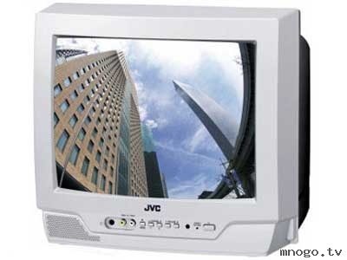
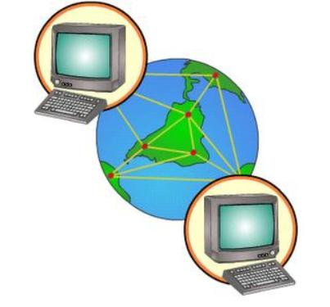
Newspapers
Radio
The Media
Television
The internet

Slide 8
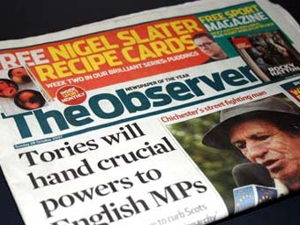
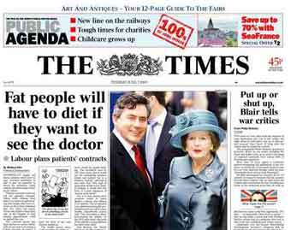
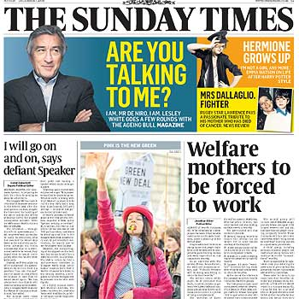
What is a Newspaper ?
It is a paper printed and sold daily or weekly with news , advertisements , articles about political, crime, business , art, entertainment , sport events.
printed -напечатанный
Sold - продаваемый
news - новости
Article-статья
Advertisement - реклама
Crime -преступление
Entertainment -развлечение

Slide 9
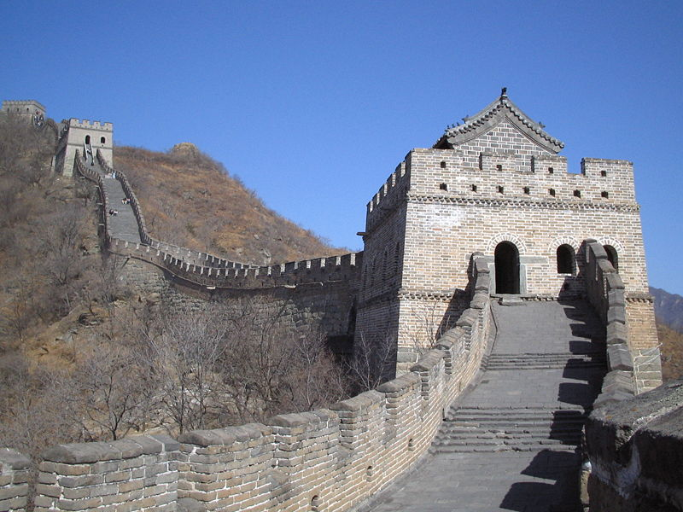
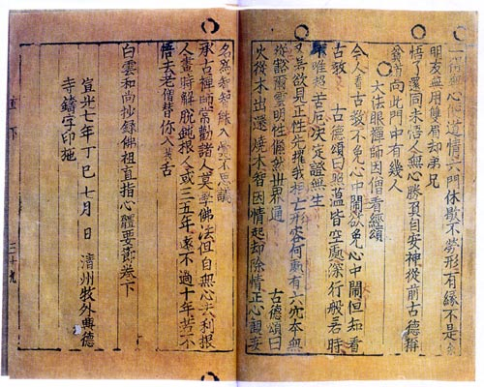
From history of newspaper…
In ancient Rome, announcement bulletins of the Acta Diurna government were made public by Julius Caesar. They were carved on stone or metal and posted in public places.
In China, early government-produced news sheets, during the late Han dynasty (second and third centuries AD).
Between 713 and 734, the Chinese Tang Dynasty published government news; it was handwritten on silk and read by government officials.

Slide 10
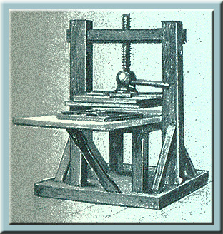
Newspapers in Britain
Printing press was invented in the15th century in Germany
!
The first newspaper in Britain appeared in 1513.

Slide 11
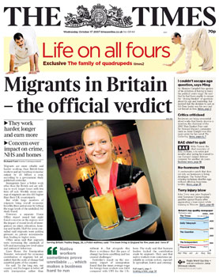
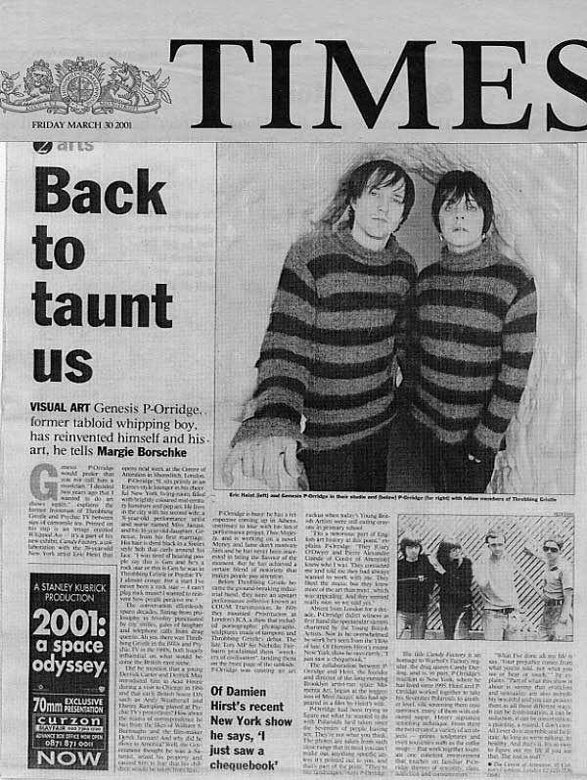
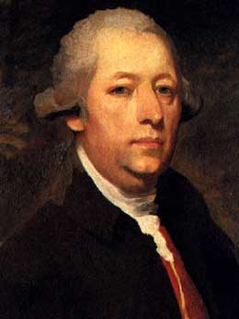
Newspapers in Britain
The longest running British newspaper is The Times began in 1785.
John Walter was a founder of The Times newspaper, London.

Slide 12
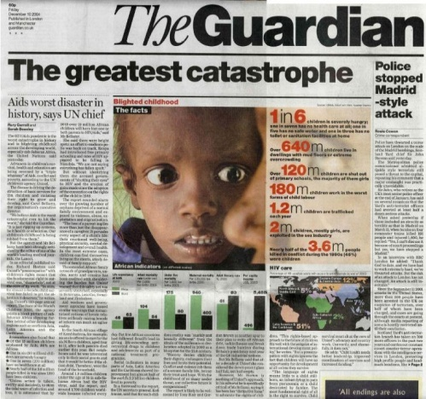
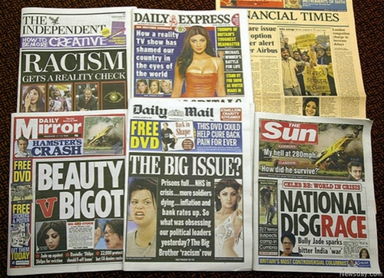
More credible
Contain political, industrial, financial and cultural news
Quality papers
There are two kinds of newspapers in Britain
Tabloids
Less credible
Sensationalism

Slide 13
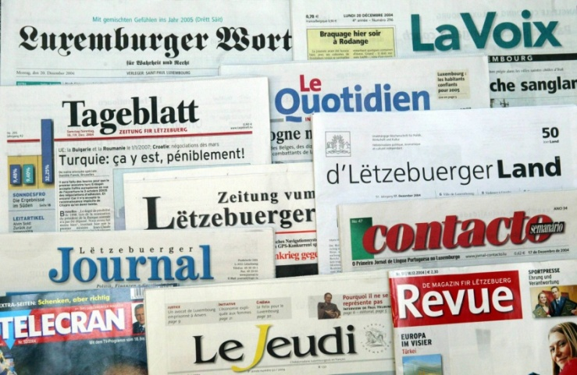
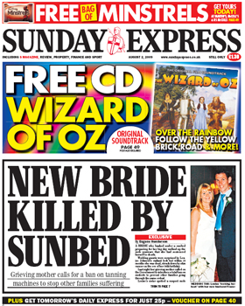
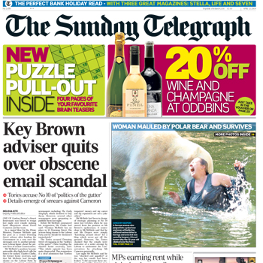
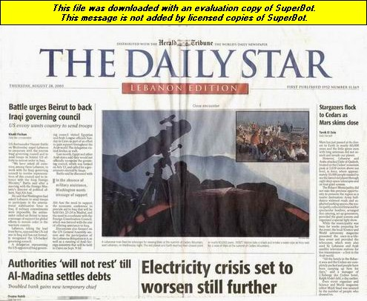
Newspapers are divided
Daily
Sunday
Published on every day of the week except Sunday
They are larger then daily ones

Slide 14
Do you like to read newspapers?
What newspapers for children do you know?
What is your favourite newspaper?
How often are you delivered it?
What articles do you like to read?
The Newspaper is the only national newspaper for 8 to 14 year old children designed for the classroom. It is produced by a small team of teachers and journalists.
It was first published in April 2000 and has been delivered to schools every half term since.
Newspapers for children

Slide 15
What is a radio?
The process of sending and receiving messages through the air , broadcasting programmers for people to listen to
People can
get news- узнать новости
take part in talk shows- принимать участие в ток-шоу
listen to music-послушать музыку

Slide 16
Find the correct translation
1.Listen to the radio
a.Включить радио
2.Turn the radio on
b.Слушать радио
c.Слушать новости по радио
3.Miss a radio programmer
4.Get news over the radio
d.Пропустить радиопередачу

Slide 17
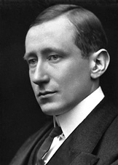
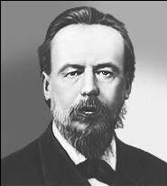
Who invented
a radio ?
Guglielmo Marconi was an electrical engineer and Nobel laureate known for the development of a practical wireless telegraphy system.
In 1896, he was awarded a patent for radio with British Patent .
On May 7, 1895 the Russian physicist Alexander Popov performed a public demonstration of transmission and reception of radio waves used for communication .This day has since been celebrated in Russia as “Radio Day”
Nikola Tesla developed means to reliably produce radio frequencies, publicly demonstrated the principles of radio, and transmitted long distant signals.

Slide 18
A Radio in the UK
BBC radio
A service of the British Broadcasting Corporation which has operated in the United Kingdom
BBC operates more than 40 stations that comprise 50% of all radio listening in the UK
The BBC radio services began in 1922.
Commercial Radio:
Started in 1970s, now includes over 300 private stations.

Slide 19
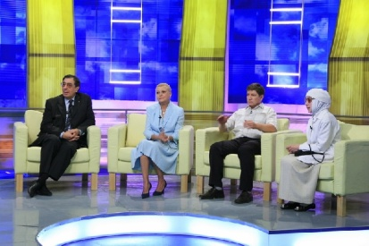
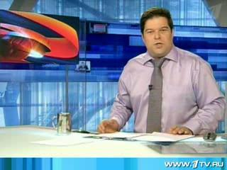
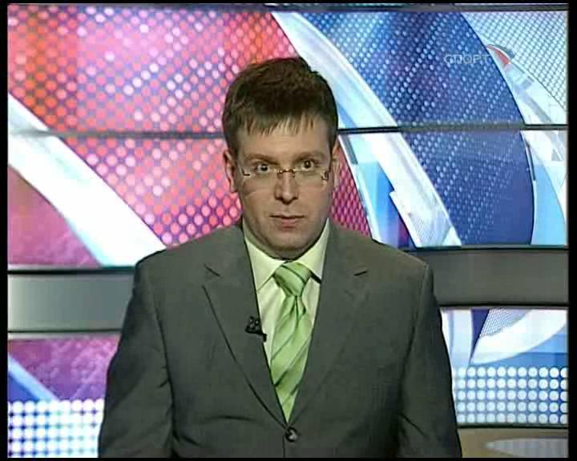
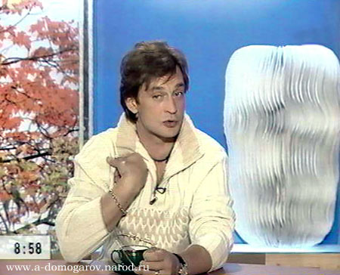
What is TV ?
Broadcasting(вещатель-ные)programmes (the news, plays,advertisements, shows) for people to watch on their television sets

Slide 20
A documentary
A programm which gives facts and information about a particular subject

Slide 21
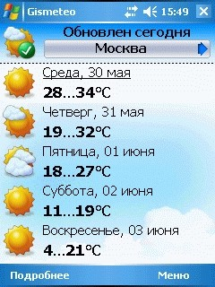
A Weather forecast
A programm ,where the announcer says what the weather will be like the next day.

Slide 22
Talk show
It is a discussion, where different problems are discussed by participants . They express their opinions, ask and answer questions.

Slide 23
Match the words with the definitions
a. a commercial interruption, where a thing, a product or a service are advertised . it helps people to choose best things.
1.A documentary
b.produced by recording images from the world with cameras, or by creating images using animation techniques or visual effects.
2.A quiz show
c. A programm which gives facts and information about a particular subject
3.An advert
e. A programmer ,where sport events are told
4.A cinema
5.Sport news
d.People take part in a competition there . They are asked questions , they can win or lose the game. If they are in luck , they get a prize.

Slide 24
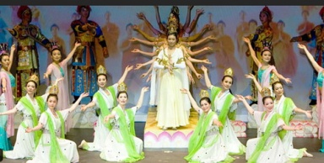
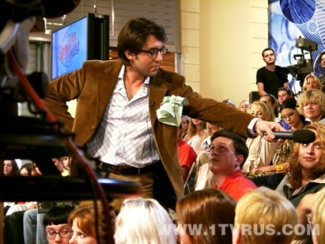
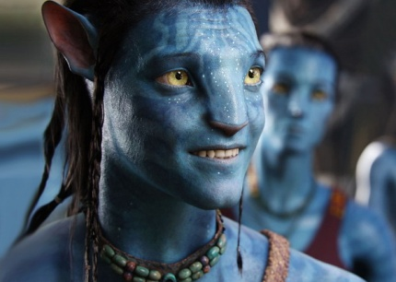
Match the definitions with the pictures
aThere are a lot of music In this kind of programmers, we can watch singers and listen to songs
1.
2.
b.A film with a lot of series , which is shown during a long time
c. A discussion, where different problems are discussed by participants . They express their opinions, ask and answer questions.
3.
d.A film with a lot of sepias , which is shown during a long time
5.
4.
e.produced by recording images from the world with cameras, or by creating images using animation techniques or visual effects.

Slide 25
Check yourself!
2.
a.There are a lot of music In this kind of programmers, we can watch singers and listen to songs
b.A film with a lot of series , which is shown during a long time
1.
3.
c. A discussion, where different problems are discussed by participants . They express their opinions, ask and answer questions.
5.
d. A programmer ,where the announcer says what the weather will be like the next day.
4.
e. produced by recording images from the world with cameras, or by creating images using animation techniques or visual effects.

Slide 26
What is it?
advert
A music programme
A talk show

Slide 27
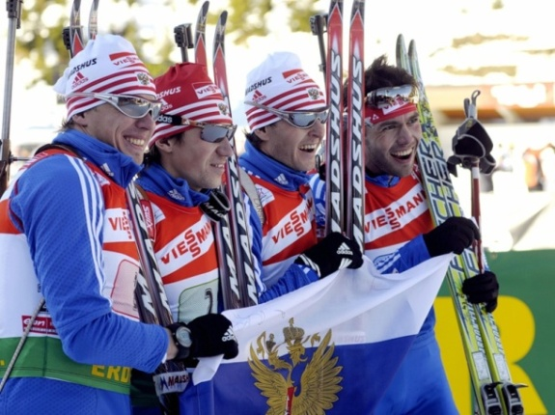
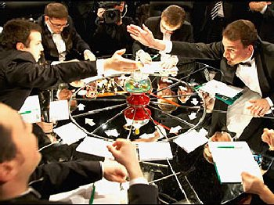
What is it?
Sport news
A quiz show
News

Slide 28
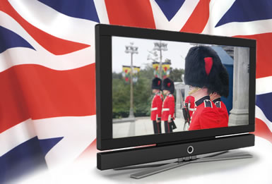
The British Television
There are 940 television broadcasts stations; 400 different TV channels in The UK.
Major British TV Channel is BBC.
BBC operates 14 different television channels

Slide 29
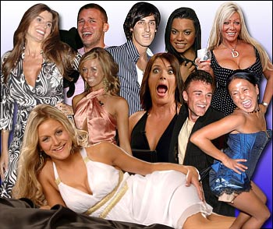
Reality TV in Britain
Programmers which ordinary people into the public eye are enjoying a wave of popularity
Popular reality TV shows in the UK
X Factor
Strictly Come Dancing
Big Brother

Slide 30
It was invented in the USA in 1965
A worldwide system of interconnected networks and computers.

Slide 31
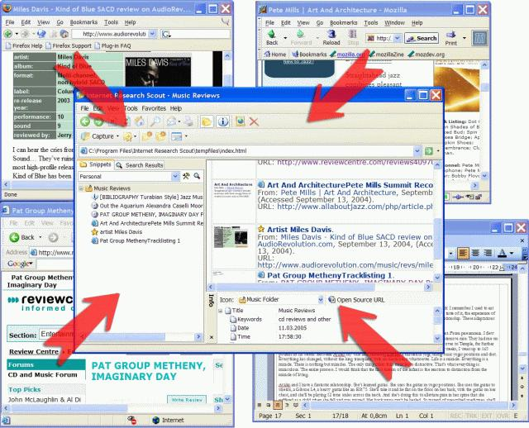
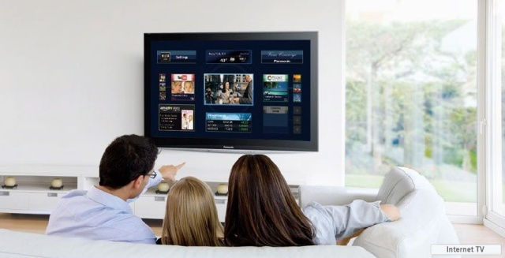
Research ,getting necessary information
Online shopping
Talking to friends
What can you do
in internet?
Download music
Downloading/
listening to music
Watching Videos

Slide 32
Disadvantages
Advantages
Disadvantages:
It promotes violence and bad behaviour within society,
It stops children from going out, as they wish to stay home and use the internet to talk to friends , to play games
Allows easy and quick access to information
People can purchase products, talk to people and much more online
Downloading music- quick and easy

Slide 33
Домашнее задание:
Составить кроссворд на тему СМИ, использую лексику по теме.

