Slide 1
Pancakes

Slide 2
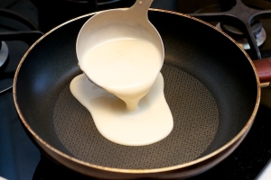
Russian people generally eat a rich and varied diet. And I would like to write a recipe of one favourite national dish.

Slide 3
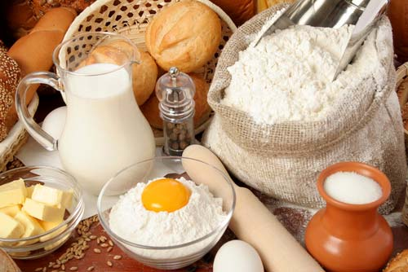
INGREDIENTs:
1 litre of milk
5 eggs
1/2 teaspoon of sault
200 grams of sugar
A pinch of baking soda
Some oil
One glass of warm water

Slide 4
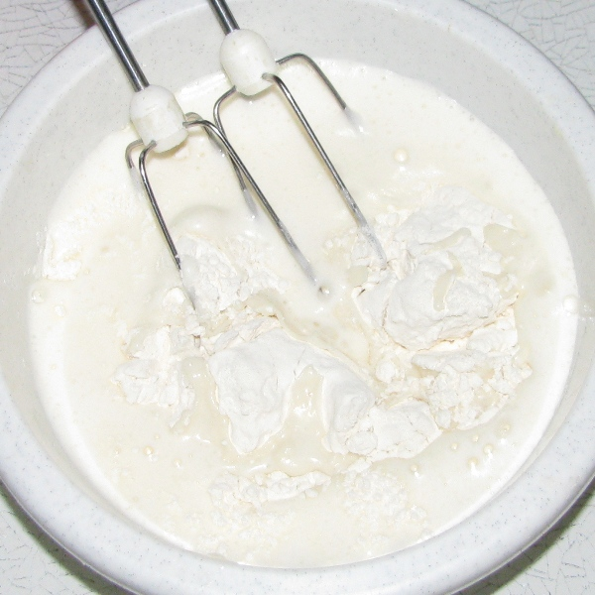
The recipe:
1. First we shake up milk with eggs, then we add some sugar and some salt, we shake up it again. Then we add some soda.

Slide 5
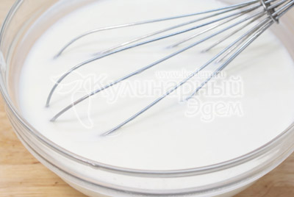
2. We put some flour in the mixture until it becomes like sour cream . The quantity of flour will depend on the size of eggs.

Slide 6
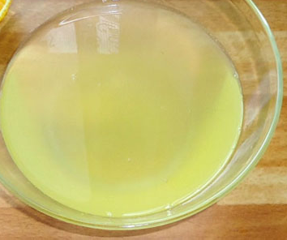
3. Then we pour some oil and a glass of warm water.

Slide 7
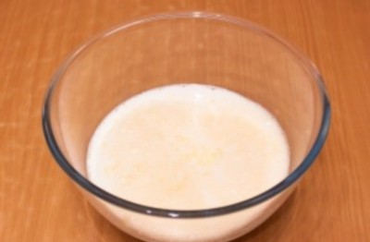
4. We bake pancakes for 2-5 minutes and serve them with jam or with a thick sour cream called smetana or with a powdered cream cheese called tvorog.

Slide 8
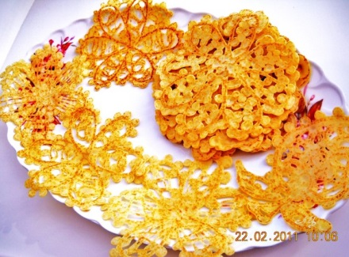
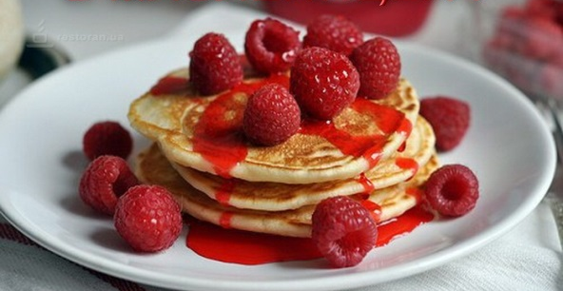
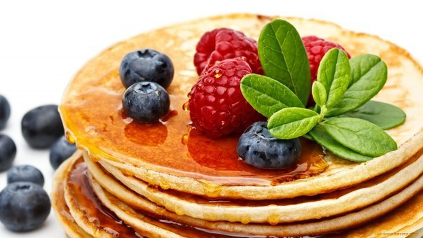
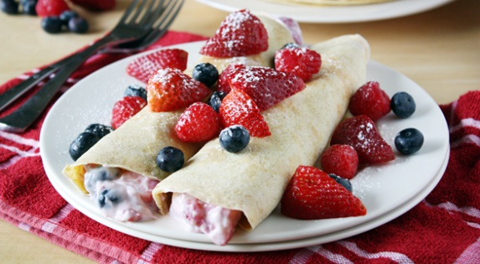
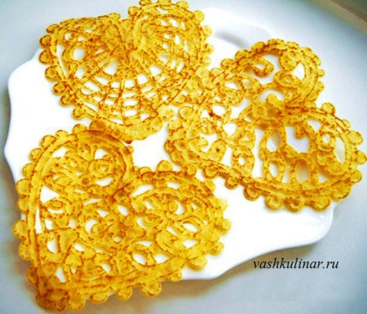
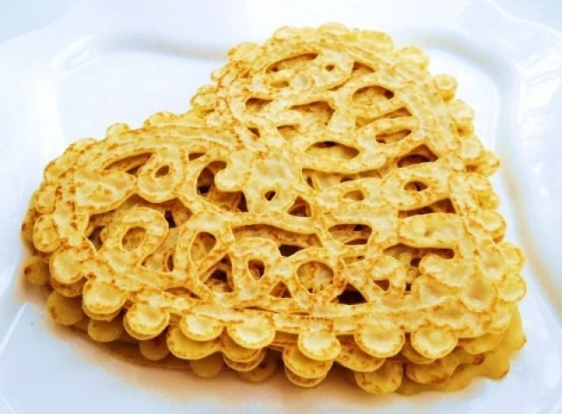
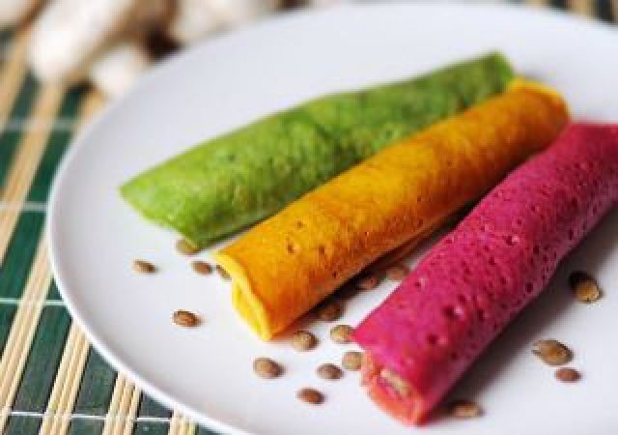
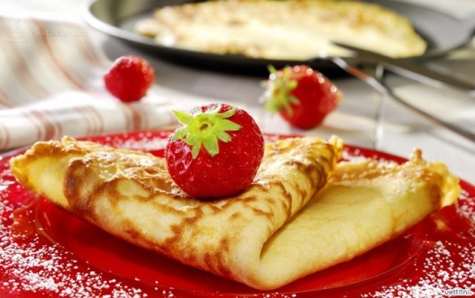
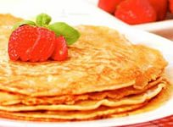

Slide 9
.
Задание: Написать рецепт блюда на английском языке, по примеру данной презентации.
Работы присылать Вк или на Gordoalena@yandex.ru
ЗАДАНИЯ ВЫПОЛНЯЕМ И ПРИСЫЛАЕМ в день, когда у Вас лента по расписанию.

