Slide 1
Указательные местоимения this, that, these, those. Этот- эти. Тот- те
.

Slide 2
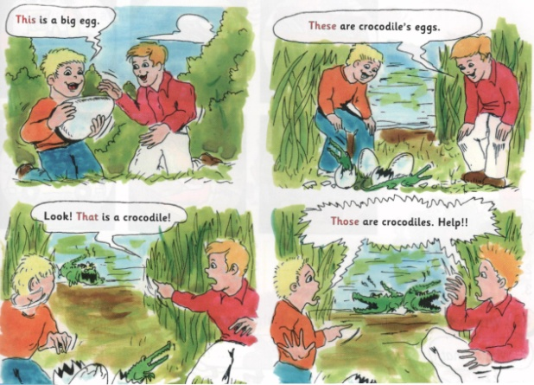
Посмотри и сравни!

Slide 3
Указательные местоимения this, that, these, those.
Тhis (ед.ч) = этот, these (мн.ч) = эти- используем с предметами, которые находятся рядом с нами.
Тhat (ед.ч) = тот, those (мн.ч) = тe- используем предметами, которые находятся далеко от нас.

Slide 4
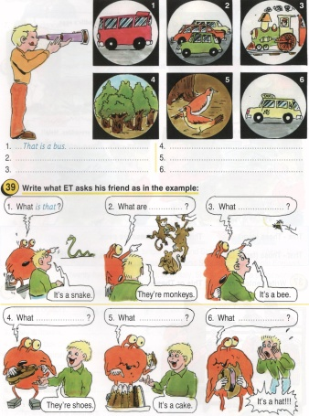
Посмотри и запиши!

Slide 5
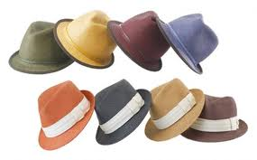
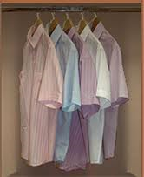
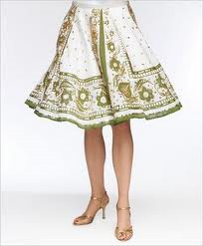
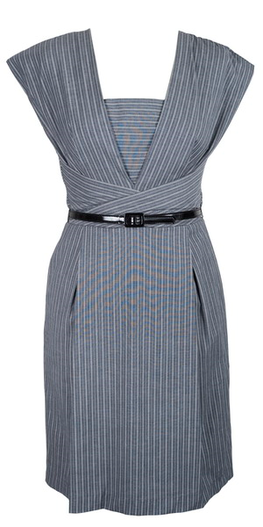
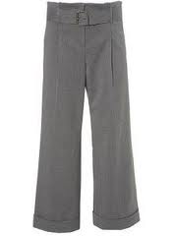
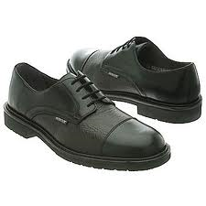
Write sentences using This or These
1. .........hats
2. .........shirts
3. .........skirt
4. .........boots
5. .........dress
6. .........trousers

Slide 6
Fill in: this, these,that or those.
1. .......... is a blue monster.
2. .......... are yellow monsters.
3. ...........are green monsters.
4. ............is a red monster.
5. ........... is a black monster.
6. ............is a white monster.
7. ...........are a brown monster.
8. ...........is a pink monster.
далеко
близко

Slide 7
Упражнение 1. Circle the right word.
This /These is a car.
That / Those are planes.
Those /That is a whale.
That / Those are sharks.
This / These is my guitar.
That / Those is an island.
Упражнение 2. Insert the correct word.
This __________ is easy. a) questions b) homework
These ___________ are my neighbors. a) women b) man
What are you doing ________ afternoon? a) that b) this
Who's ________ speaking? a) this b) it
These are my glasses and ________ are hers. a) those b) that
We are going to the seaside __________ summer. b) this a) that
__________ man over there is a famous politician. b) These a) That
Упражнение 3. Insert this, that, these, those.
None of _______ present expressed any surprise on hearing __________.
Try one of _____________.
_________ is a computer
___________ are the TV sets of the latest type.
Suddenly I felt something soft and warm on my knees. _________ was a cat.
Whom were you talking with? ________ was a friend of mine.

Slide 8
Упражнение 4. Fill in the gaps with this, that, these, those.
_________ people over there are waiting for the bus
The day I first came to London was wonderful. I will remember _______day for ever.
______ summer I'm pretty busy.
I'm working as a receptionist _______days.
________ were the days!
Do you remember _______ winter when we all went to Egypt?
Hello!__________ is Alan. Can I speak to Harry, please?
_________ is a new cathedral and _________ one over there was built 900 years ago.
Will you come over at five o'clock? I'll be at home at _________ time.
The summer of 1999 I spent in the country. I remember we had a lot of rain _______ year.
_________ are my sisters. They have just arrived from London.
Who was ________ girl I saw you with last night?
Do you want to sit on ______chair here or on ________ one over there?
_________ sweets you gave me last night were very nice.
Look at _______ colourful air balloons in the sky!
Clyde and Nancy have decided to buy a house ______ year.
_________ trees over there were planted by the pupils of our school
______ buildings just in front of you were erected in the 18th century.
Hello, Mrs Swift.________ is Mr Willis from Globe &Co speaking
I wish I would have bought ______ woolen sweater last Sunday.
You'd better take ________ The others we saw don't match your dress.
I couldn't forget_________ beautiful girl I had met in the park.
Do you know ________ little boy? He says he has been lost in the shop
Can you reach ________ old books on the top shelf?

Slide 9
Готовые задания скидывать на Gordoalena@yandex.ru или ВК

