Slide 1
Make
or
Do

Slide 2
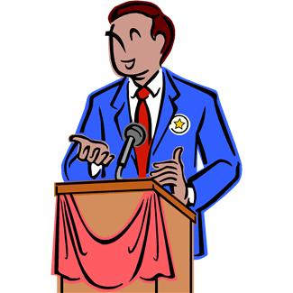
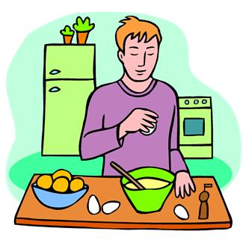
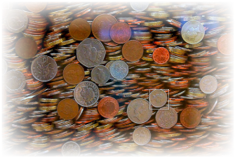



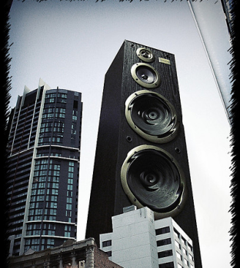
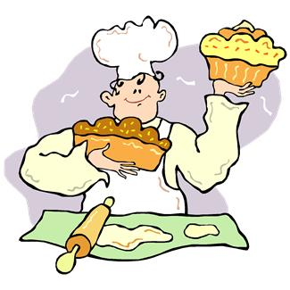
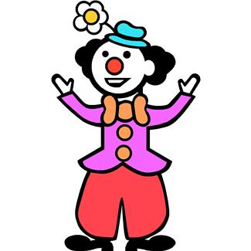
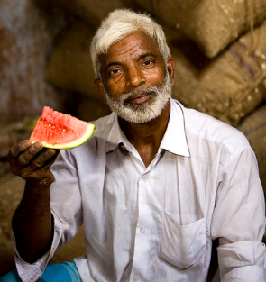
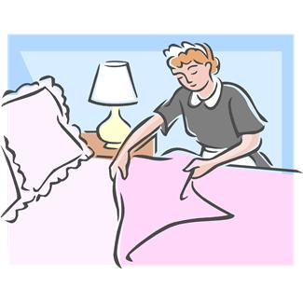
a phone call
speech
breakfast
money
Make
a journey
progress
a mistake
cakes
laugh
noise
the bed
an offer

Slide 3
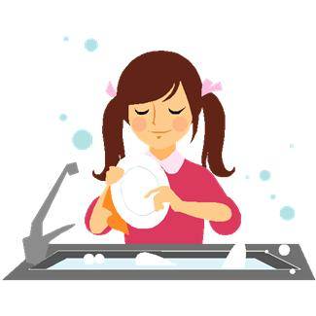
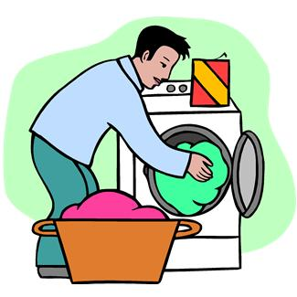

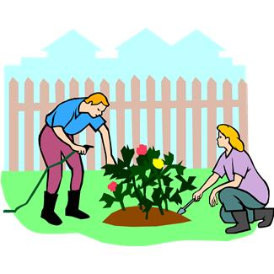
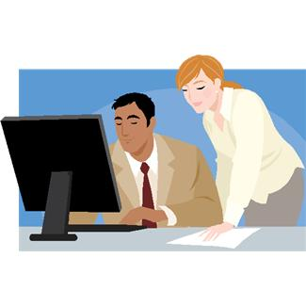
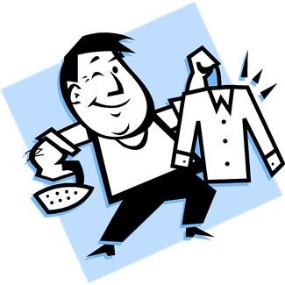
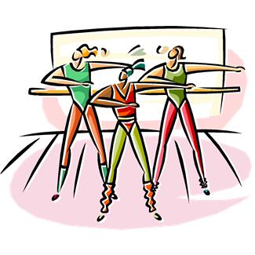
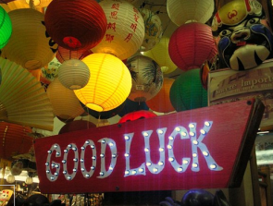
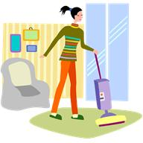
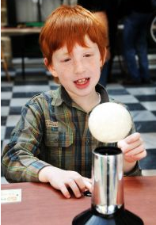


the washing up
the homework
the washing
the gardening
Do
business
the ironing
aerobics
good
the housework
an experiment
the shopping
a job

Slide 4
Fill in “make” or “do” in the correct form.
1. I _______ our breakfast every morning.
2. I always _______ the washing up after lunch.
3. Mr. Baker _______ delicious cakes. We love them!
4. Mr. Jones _______ a lot of money when he sold
his company.
5. Sally _______ the homework with her father.
6. Mr. Black _______ a mistake with his password,
so he couldn’t log in.
7. Mum _______ the shopping every Friday after work.

Slide 5
Задания:
Сделать конспект
Выполнить упражнения
Работы присылать Вк или на Gordoalena@yandex.ru
ЗАДАНИЯ ВЫПОЛНЯЕМ И ПРИСЫЛАЕМ в день, когда у Вас лента по расписанию.

